Slide 1

8020fit.ai sprint 0
FITNESS
FITNESS
FITNESS
FITNESS
FITNESS
FITNESS
FITNESS
Presented by Team fitforce

Slide 2
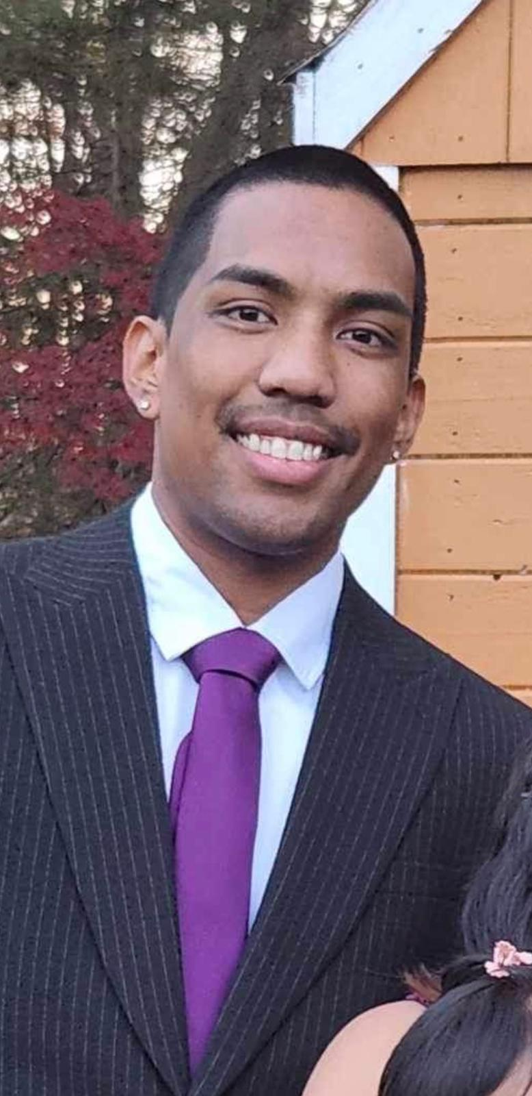
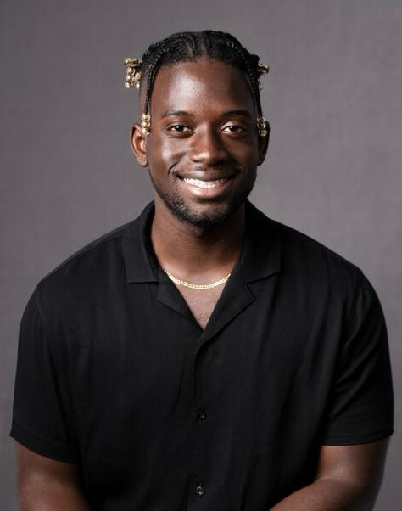
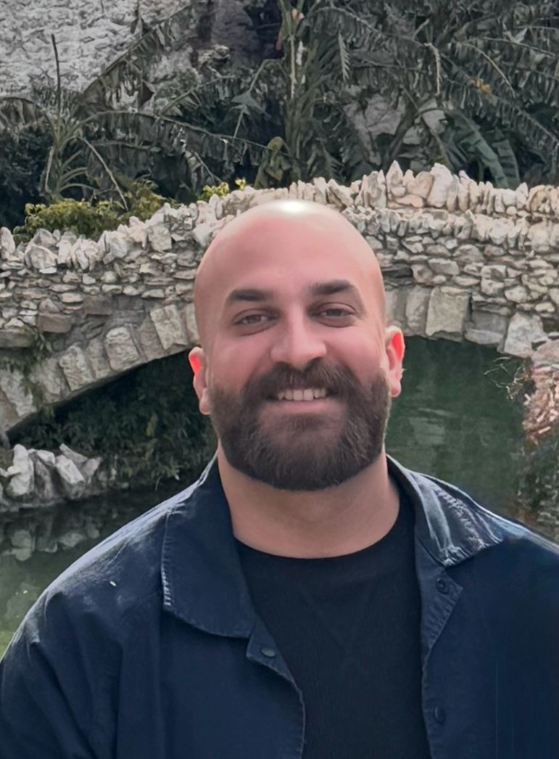
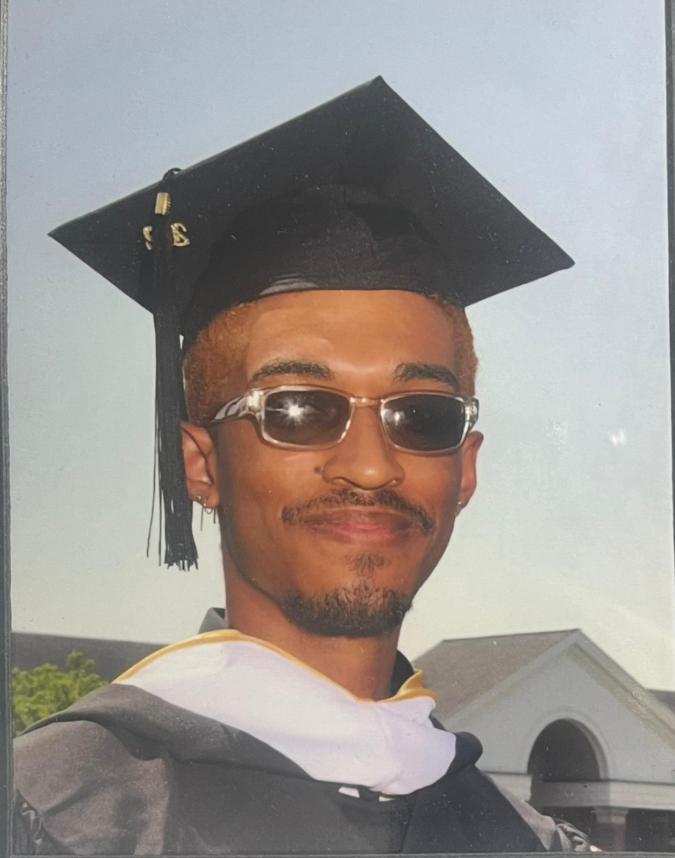
MEET the fitforce team
Adrian egasan
Yaw Mensah
Mustafa al-tameemi
Miguel lugo
Front End Developer
Back End Developer
Back End Developer
Front End Developer

Slide 3
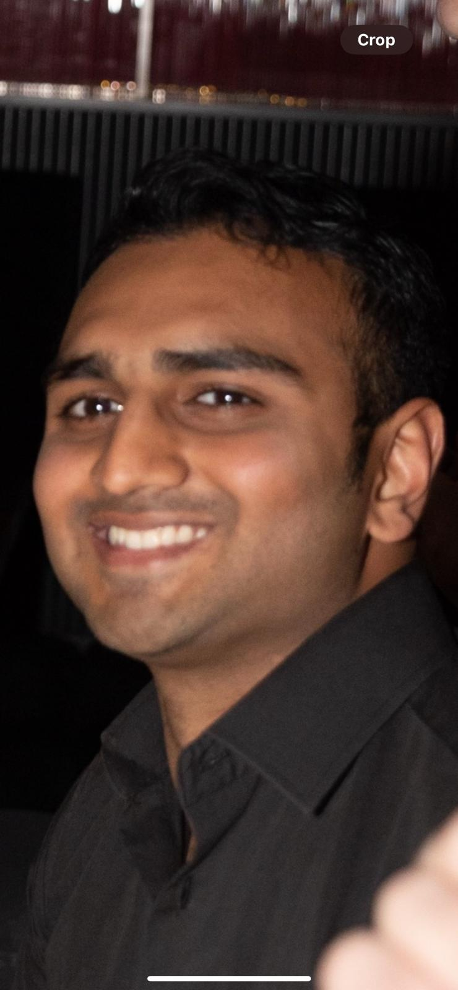
MEET THE FITFORCE TEAM
ROHAN PATEL
Back End Developer

Slide 4

AGENDA
Problem statement
Project description
Personas
technologies
Algorithms
Project schedule
Retrospective
Working agreement
Wiki link page
AGENDA
AGENDA

Slide 5

Problem
problem
Problem
People fail to achieve their nutrition and fitness goals due to overcomplicated health/fitness apps, lack of education, hectic lifestyles, expensive personal trainers & gym memberships, and misinformation in the nutrition & fitness industries.

Slide 6

Project
8020FIT.AI is a comprehensive webapp deigned to optimize nutrition and fitness tracking. End users will take an in-depth quiz on what their nutrition and fitness goals are as well as body measurements and goal body measurements. The AI will then create custom tailored workouts and meal plans for the user. End users will also be able to log their workouts and macros to see if they’re on track.
Project
Project

Slide 7

Working
professional
persona
Age: 28
Occupation: Marketing Manager
Fitness Level: Beginner
Technology Comfort: Moderate
Goals: She wants to increase energy levels and lose weight, prefers quick and efficient.
Challenges: limited time due to a demanding job, limited knowledge about effective workout routines, hard to stay motivated.

Slide 8

college
student
persona
Age: 22
Occupation: Student
Fitness Level: Intermediate
Technology Comfort: High
Goals: Build muscle and increase strength, trying new workout routines.
Challenges: Limited equipment availability at his gym so he prefers body weight and minimal equipment exercises, needs a variety of workouts to prevent boredom

Slide 9

Middle aged
mom
persona
Age: 38
Occupation: Stay at home parent
Fitness Level: Beginner
Technology Comfort: Low to moderate
Goals: Maintaining health and boosting energy for her family, prefers low-impact exercises that can fit around her children’s schedules
Challenges: Finds it challenging to set aside dedicated time for workout, overwhelmed by complex fitness apps, needs workouts that are gentle but effective, due to past injuries

Slide 10
Technologies
Technologies
Technologies
Programming languages
Tools
Back End: Python, Node.js
Front End: React, Javascript
Visual Studio Code
AWS Amplify

Slide 11
Technologies
Technologies
Technologies
database
API
AWS DynamoDB
Workout Manager (wger) API

Slide 12
algorithms
algorithms
algorithms
Arithmetic
Decision tree
Restful data fetching
Provides accurate calculation of Body Mass Index (BMI) along with other crucial metrics
Creates custom tailored workout recommendations for the end user
Allows us to get data from a local or remote server via Workout Manager (wger) API
Notes:
What went well:
Quick decision: team members quickly established project idea as well as roles and responsibilities
Flexibility: team members were open to scheduling more meetings than necessary to get in alignment with each other for the project
Clarity: ideas started coming together as soon as the team started executing on respective action items, structuring the information on the slides, and getting clear on the working agreement
What can be improved:
Late planning: led to a rushed feeling, we did not know much about the project until January 25th when we could have started January 21st
Meeting structure: everyone needs to be clear on their own action items as well as other group members action items to be in sync
Communication: proactively letting the group know what they did on the project so other group members quickly test and verify it
What will we implement moving forward:
Implement a framework for our meetings moving forward where we know what exactly each of us is doing in the project at any moment in time
Team members will be asked to use the tracker to give themselves deadlines as well as check when tasks are complete
Update each other once every three days to see where everyone is with their responsibilities

Slide 13
algorithms
algorithms
algorithms
Real time data sync
Progress prediction
Authentication/access control
To keep frontend data in sync with backend
To predict user performance trends
Secures API and data access using AWS Amplify Auth (Cognito) with role-based access control
Notes:
What went well:
Quick decision: team members quickly established project idea as well as roles and responsibilities
Flexibility: team members were open to scheduling more meetings than necessary to get in alignment with each other for the project
Clarity: ideas started coming together as soon as the team started executing on respective action items, structuring the information on the slides, and getting clear on the working agreement
What can be improved:
Late planning: led to a rushed feeling, we did not know much about the project until January 25th when we could have started January 21st
Meeting structure: everyone needs to be clear on their own action items as well as other group members action items to be in sync
Communication: proactively letting the group know what they did on the project so other group members quickly test and verify it
What will we implement moving forward:
Implement a framework for our meetings moving forward where we know what exactly each of us is doing in the project at any moment in time
Team members will be asked to use the tracker to give themselves deadlines as well as check when tasks are complete
Update each other once every three days to see where everyone is with their responsibilities

Slide 14

Schedule
Mondays @ 7:30pm
weekly
spr 000
January 25 – February 10
Schedule
spr 001
February 10 – March 10
Schedule
spr 002
March 10 – April 7
Spr 003
April 7 – May 5

Slide 15
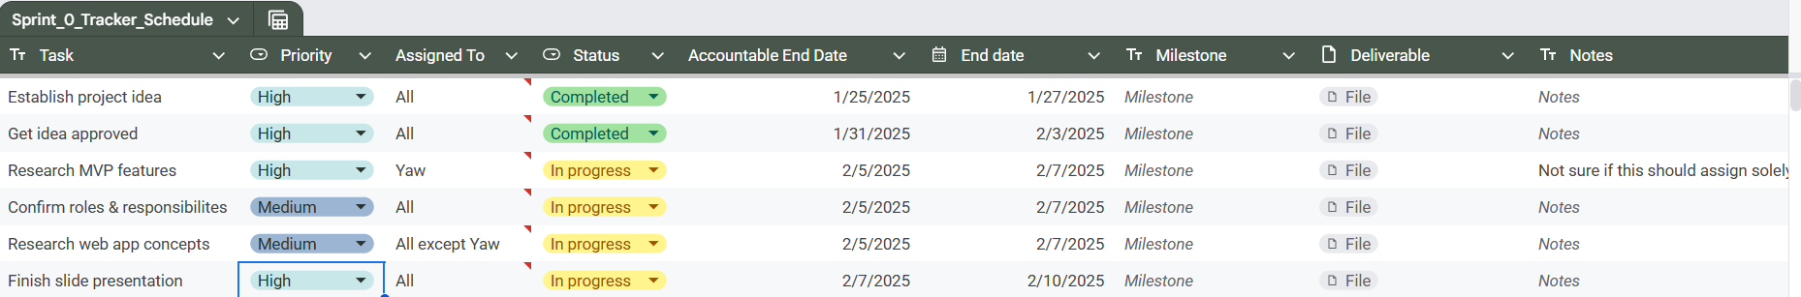
tracker
Project

Slide 16
Retrospective
Retrospective
retrospective
Good
Bad
Apply
Quick decision making led to good project idea and establishing roles
Flexibility on working together and meeting
Clarity when team started executing on action items
Late planning that led to a rushed feeling
Meeting structure was lacking
Communication in the group chat regarding task updates
Implement a framework for meetings
Team members will update the task tracker so that we can manage the project
Update each other every three days on task status
Notes:
What went well:
Quick decision: team members quickly established project idea as well as roles and responsibilities
Flexibility: team members were open to scheduling more meetings than necessary to get in alignment with each other for the project
Clarity: ideas started coming together as soon as the team started executing on respective action items, structuring the information on the slides, and getting clear on the working agreement
What can be improved:
Late planning: led to a rushed feeling, we did not know much about the project until January 25th when we could have started January 21st
Meeting structure: everyone needs to be clear on their own action items as well as other group members action items to be in sync
Communication: proactively letting the group know what they did on the project so other group members quickly test and verify it
What will we implement moving forward:
Implement a framework for our meetings moving forward where we know what exactly each of us is doing in the project at any moment in time
Team members will be asked to use the tracker to give themselves deadlines as well as check when tasks are complete
Update each other once every three days to see where everyone is with their responsibilities

Slide 17
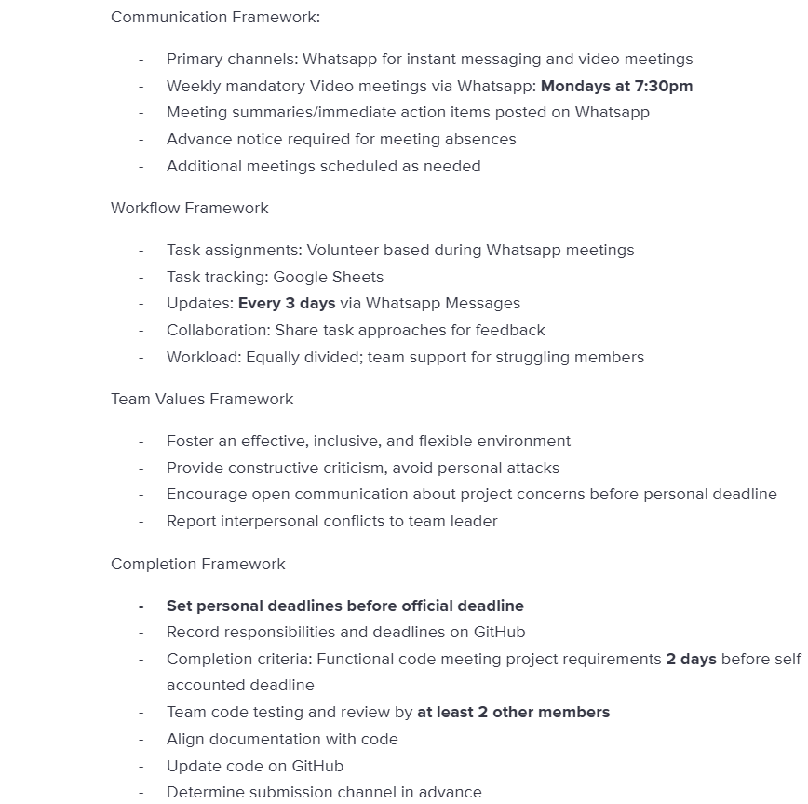
Overview
WORKING AGREEMENT

Slide 18

THANK YOU
THANK
YOU
THANK
YOU
THANK
YOU
THANK
https://github.com/htmw/2025sa-team2/

